Slide 1



BUILDING
RECOMMENDATION
ENGINES
WITH SPRING

Slide 2


Michael Minella
Twitter: @michaelminella
Home page: spring.io/team/mminella

Slide 3


http://github.com/mminella/RecommendationEngine

Slide 4


Slide 5
11
14
7
12
20
16
5
17
6
3
2
8
18
13
4
1
10
19
23
15
9

Slide 6



Slide 7

RECOMMENDATION
ALGORITHMS

Slide 8

BIG
REAL-TIME
GEMFIRE
AMBARI
GROWING
YARN
HAWQ
SQOOP
HBASE
STORM
INTERNET OF THINGS
PETABYTE
MAP REDUCE
DATA
PIVOTAL HD
MAHOUT
FLUME
RECOMMENDATIONS
HIVE
SPARK
OOZIE
HADOOP
SPRING
PIG

Slide 10
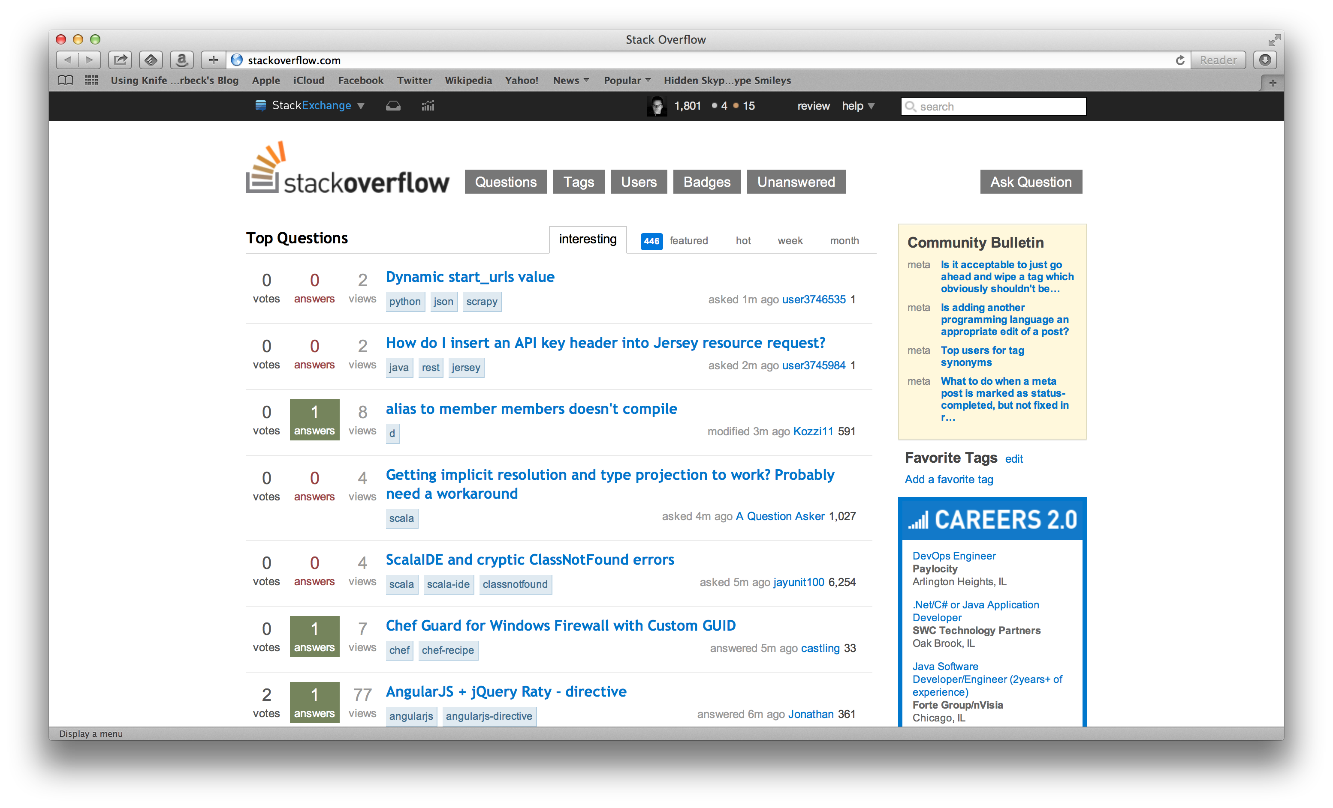

Slide 11
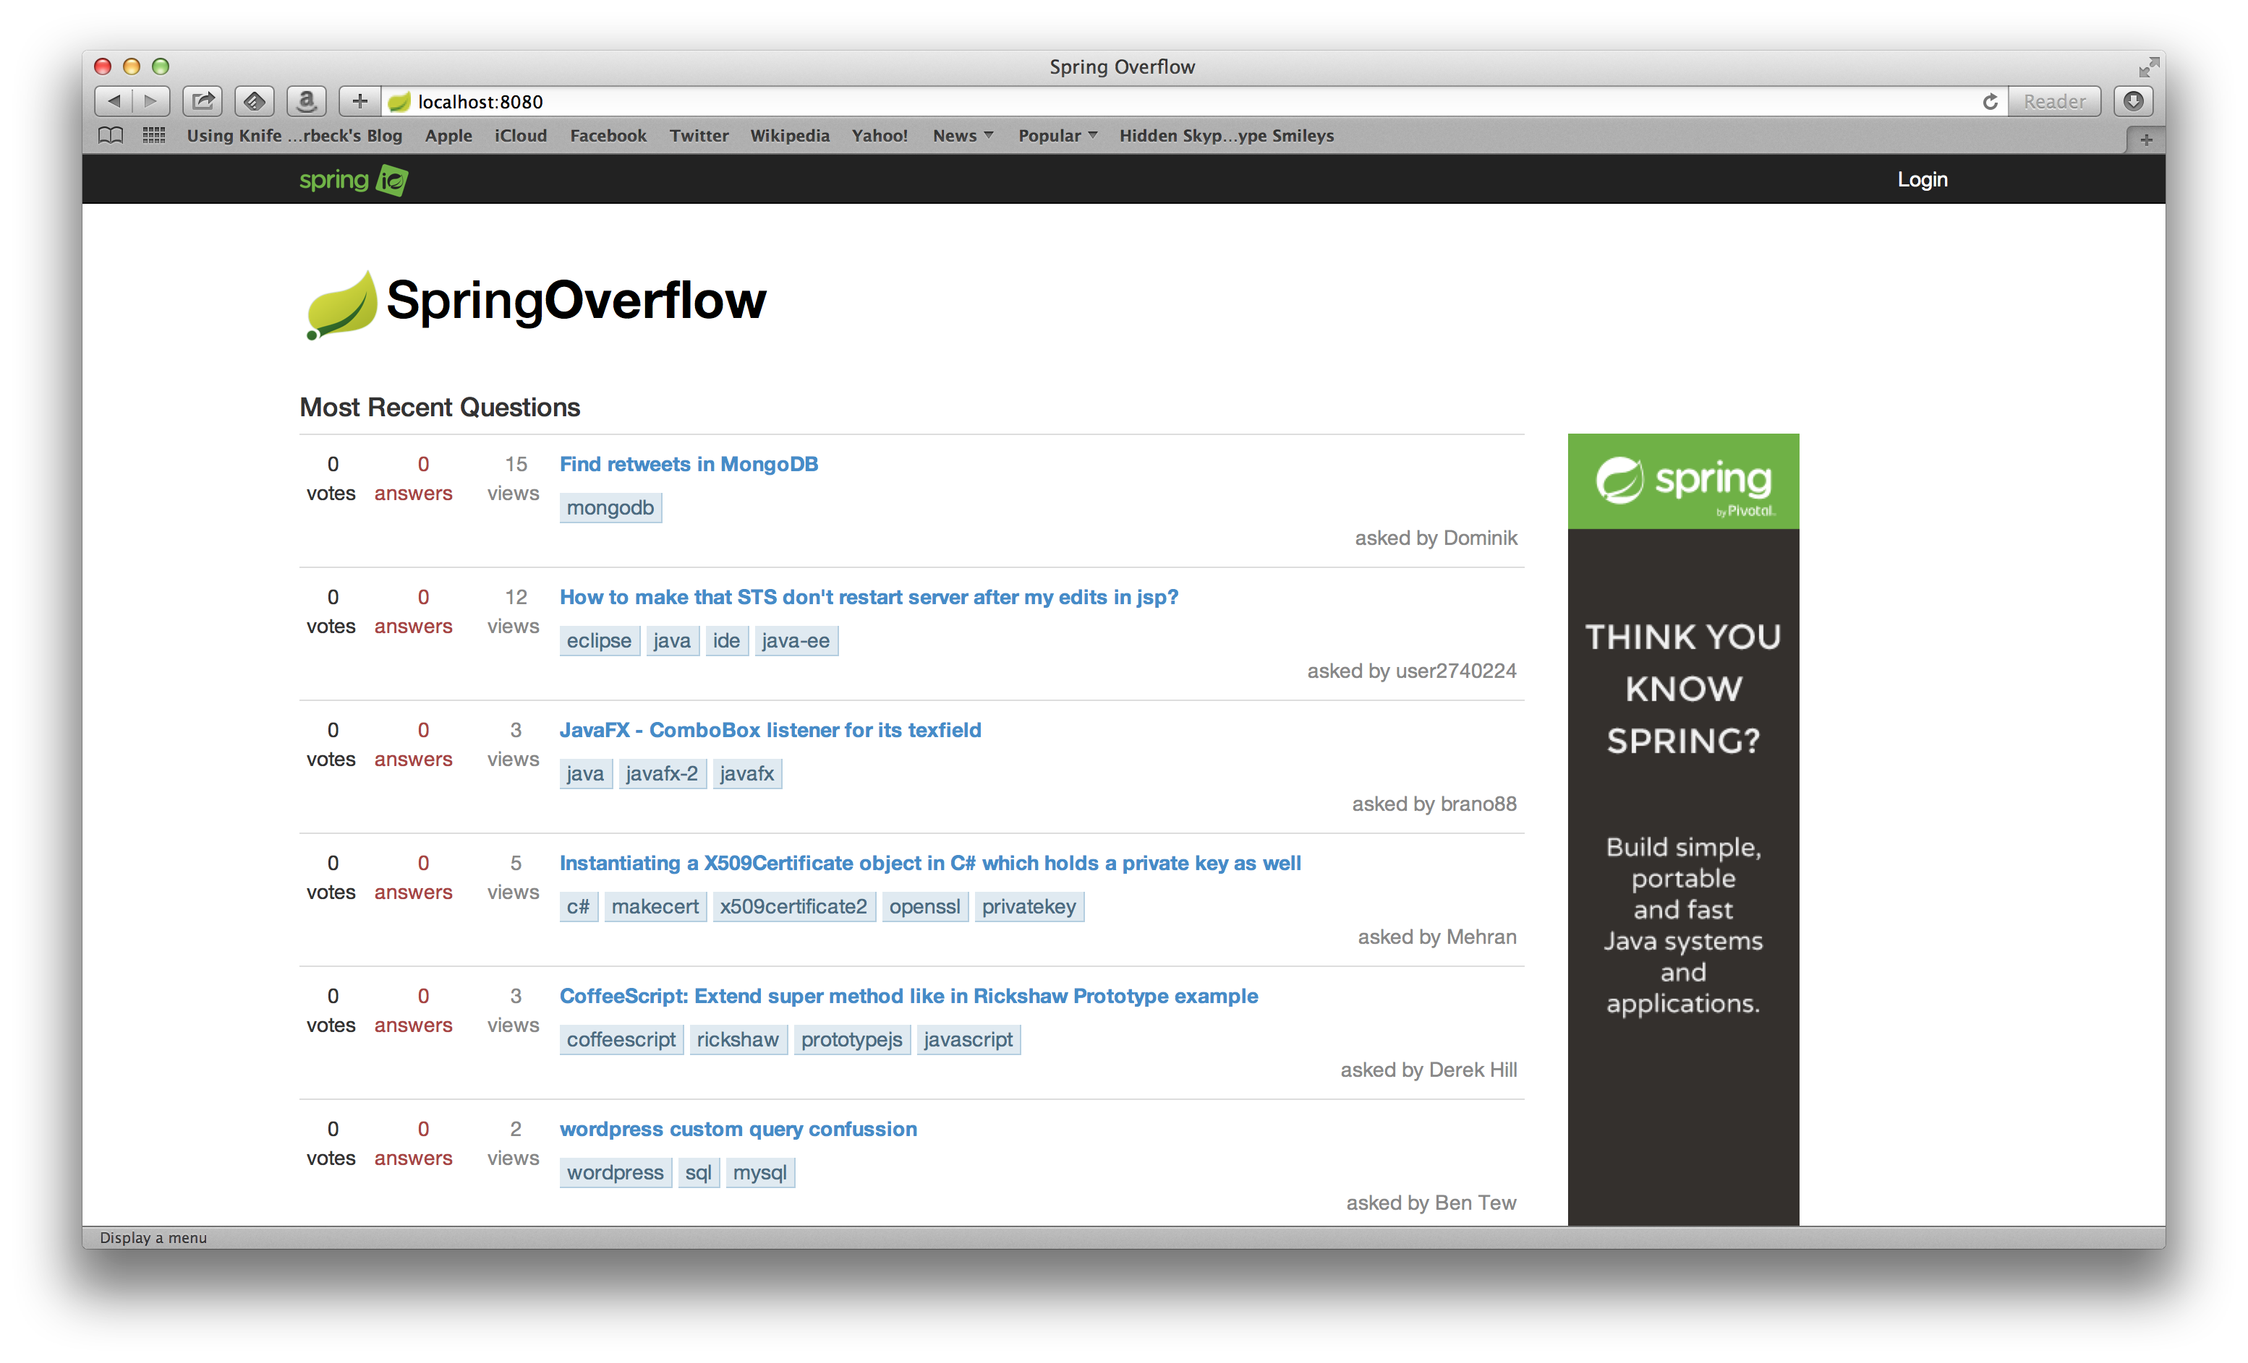

Slide 12



+
=

Slide 13
JSR-352

Slide 14
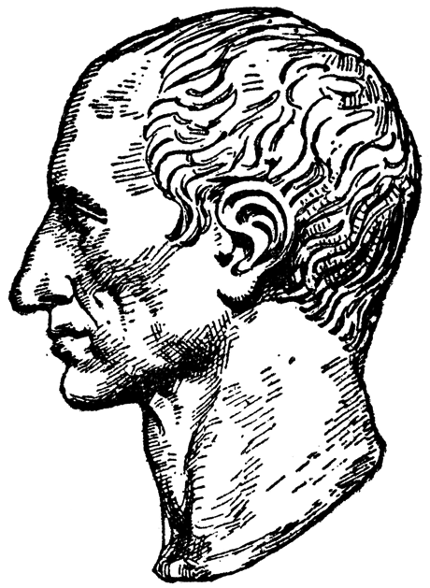
JSR-352 introduces an exciting new Java
specification for building, deploying, and
running batch applications.
- Chris Vignola

Slide 15

Over 6 years of
production experience

Slide 17
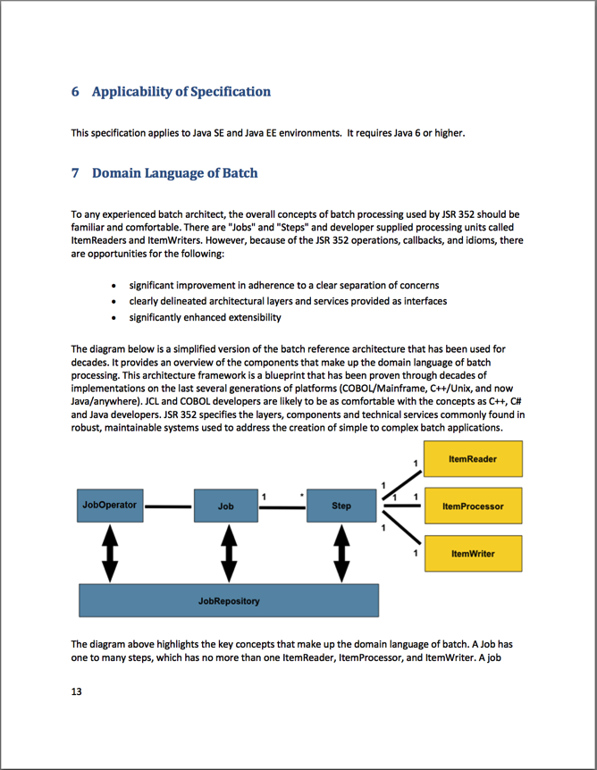
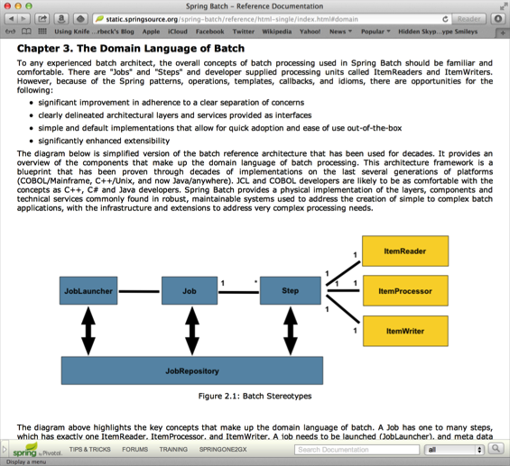

Slide 18

Structurally, JSR-352 and Spring Batch
are similar

Slide 19
1
API

Slide 20
2
DSL

Slide 21
3
CONTRACT

Slide 22

JSR-352 is a specification…
not an implementation

Slide 23
SPRING BATCH 3.0

Slide 24

100% JSR-352
COMPLIANT

Slide 25

System.out.println(“Hello World!”);

Slide 26

NO DEPENDENCY
INJECTION REQUIRED

Slide 27

OPTIONS
DEPENDENCY
INJECTION

Slide 28
<!– Inline -->
<batchlet ref=”io.spring.MyBatchlet”/>

Slide 29
<!– batch.xml-->
<batch-artifacts>
<ref id=”myArtifact"
class=“io.spring.MyArtifact"/>
</batch-artifacts>

Slide 30
<!– Spring DI-->
…
<bean id=“batchlet”
class=”io.spring.MyBatchlet”/>
…

Slide 31
FILE
DATABASE

Slide 32

BATTLE TESTED
COMPONENTS

Slide 33

JSR-352
IS A SUBSET OF
SPRING BATCH

Slide 34
1
LAUNCHING

Slide 35
2
JAVA
CONFIGURATION

Slide 36
3
INHERITENCE

Slide 37
4
TYPE SAFE
PROPERTIES

Slide 38
5
SCALABILITY

Slide 39
6
SPRING!

Slide 40


Slide 41
+
=

Slide 42
“ARCHETYPES”
RC
P

Slide 43

SPRING BOOT
SPRING OPINIONATED

Slide 44

SPRING BOOT MAKES STARTUP
EASIER

Slide 45
FILE
DATABASE
NOW
WITH
MESSAGING!

Slide 46

LAUNCHING AND
STATUS UPDATES

Slide 48
BIG
REAL-TIME
GEMFIRE
AMBARI
GROWING
YARN
HAWQ
SQOOP
HBASE
STORM
INTERNET OF THINGS
PETABYTE
MAP REDUCE
DATA
PIVOTAL HD
MAHOUT
FLUME
RECOMMENDATIONS
HIVE
SPARK
OOZIE
HADOOP
SPRING
PIG

Slide 49

SPRING XD
BIG DATA SIMPLIFIED

Slide 50

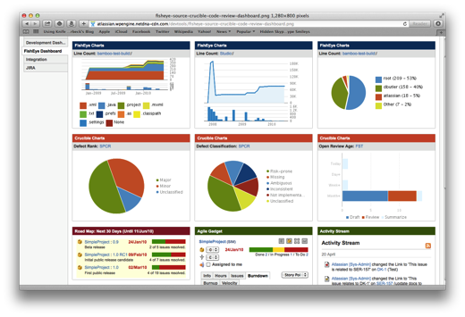





Ingestion
Orchestration
SPRING
Extraction
Real-time
Analytics
Notes:
Spring XD handles everything in the circle

Slide 51
BIG
REAL-TIME
GEMFIRE
AMBARI
GROWING
YARN
HAWQ
SQOOP
HBASE
SQOOP
STORM
INTERNET OF THINGS
PETABYTE
MAP REDUCE
MAP REDUCE
DATA
MAHOUT
FLUME
PIVOTAL HD
MAHOUT
RECOMMENDATIONS
HIVE
HIVE
SPARK
OOZIE
OOZIE
HADOOP
SPRING
PIG
PIG

Slide 52

SPRING XD
BATCH JOBS
RUNNING ON

Slide 53

Learn More. Stay Connected.
Spring Batch
Project: spring.io/spring-batch
Github: github.com/spring-projects/spring-batch
Jira: jira.spring.io/browse/BATCH
Spring Boot
Project: spring.io/spring-boot
Github: github.com/spring-projects/spring-boot
Spring XD
Project: spring.io/spring-xd
Github: github.com/spring-projects/spring-xd
Jira: jira.spring.io/browse/XD
Twitter: twitter.com/springcentral
YouTube: spring.io/video
LinkedIn: spring.io/linkedin
Google Plus: spring.io/gplus

Slide 54

The
End

Slide 55












Increase by Attilio Baghino from
The Noun Project
Question by Jessica Lock from
The Noun Project
Servers by Jaime Carrion from
The Noun Project
Twitter by Maria Maldonado from
The Noun Project
Running by Dillon Arloff from
The Noun Project
Syringe by Gilad Fried from
The Noun Project
List by Agus Purwanto from
The Noun Project
Arrows by Juan Pablo Bravo from
The Noun Project
Tank by Renan Ferreira Santos from
The Noun Project
Hammock by Adam Mullin from
The Noun Project
Architect by Luis Prado from
The Noun Project
Database by Anton Outkine from
The Noun Project

